Slide 1
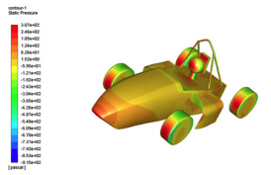
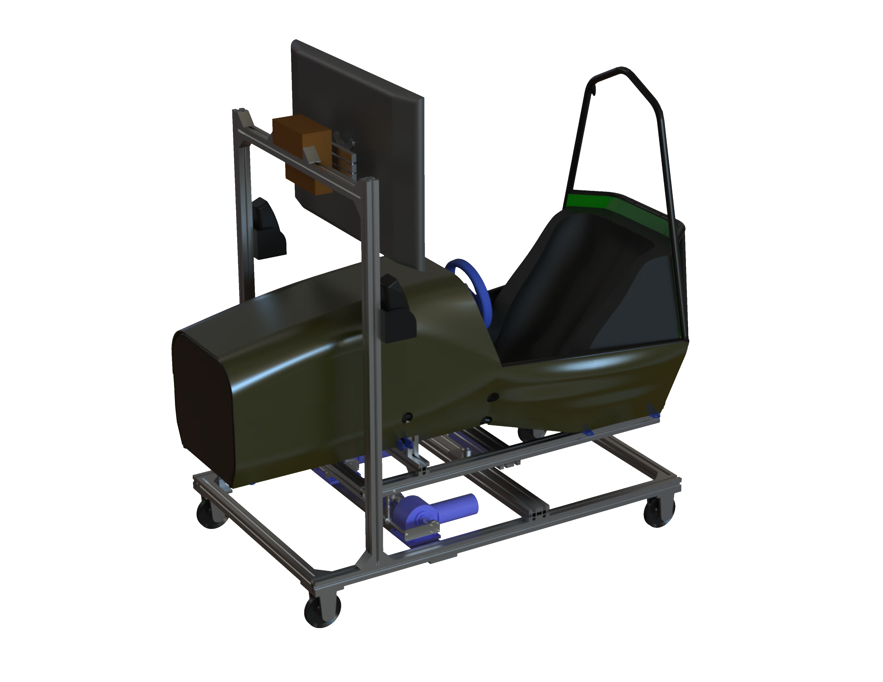
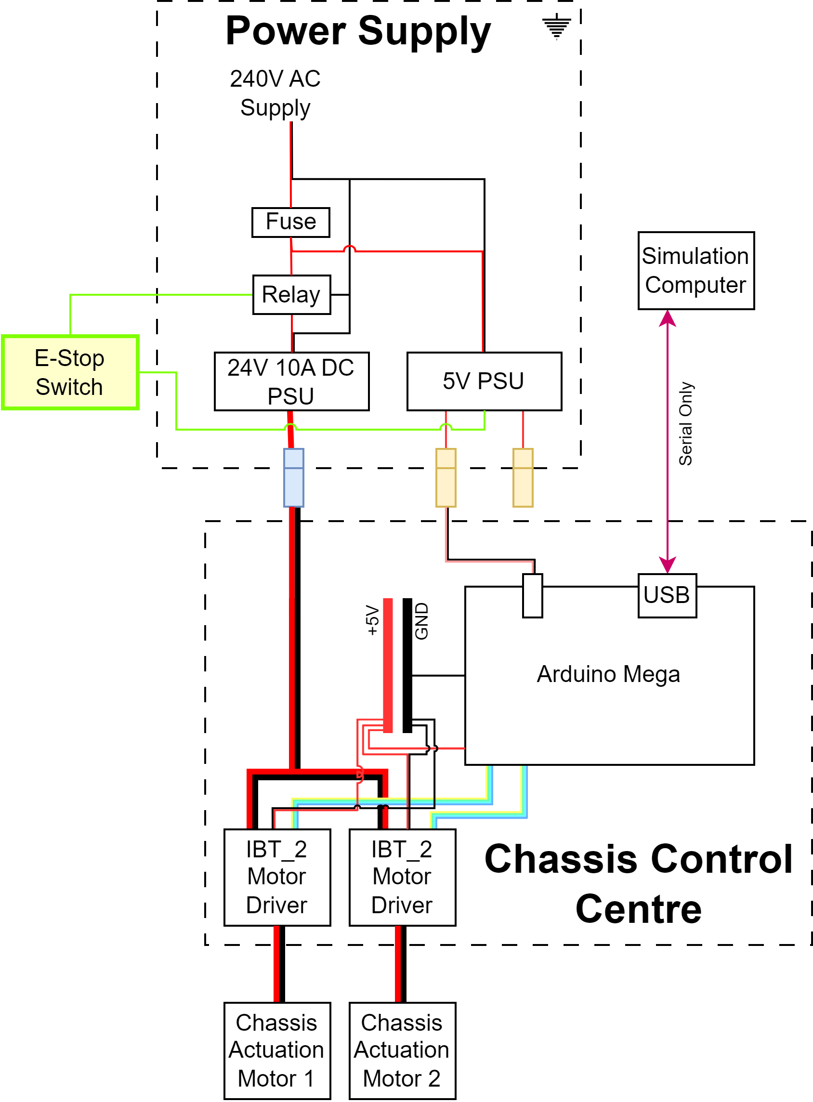
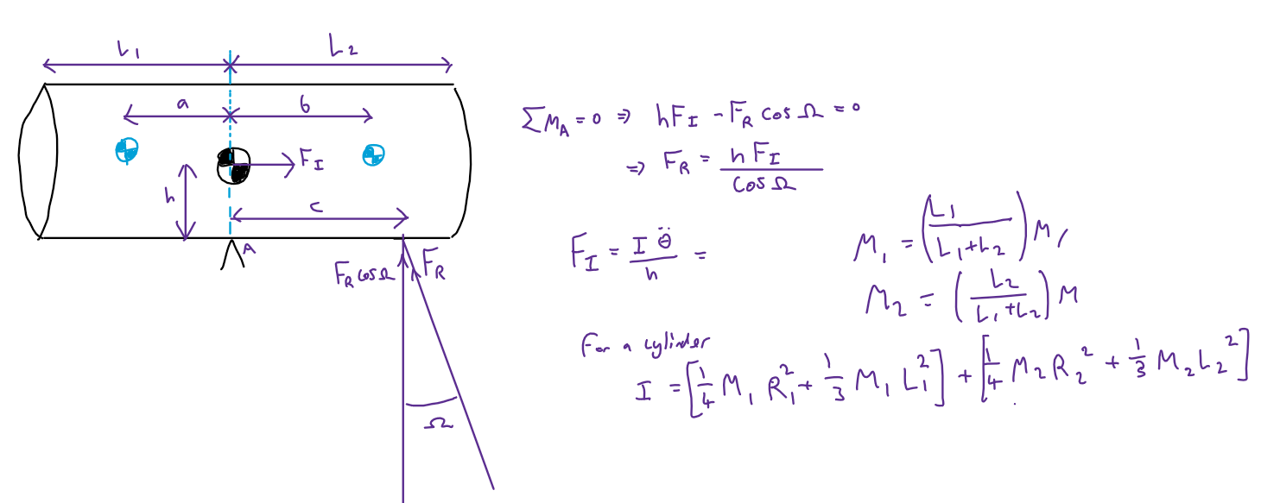
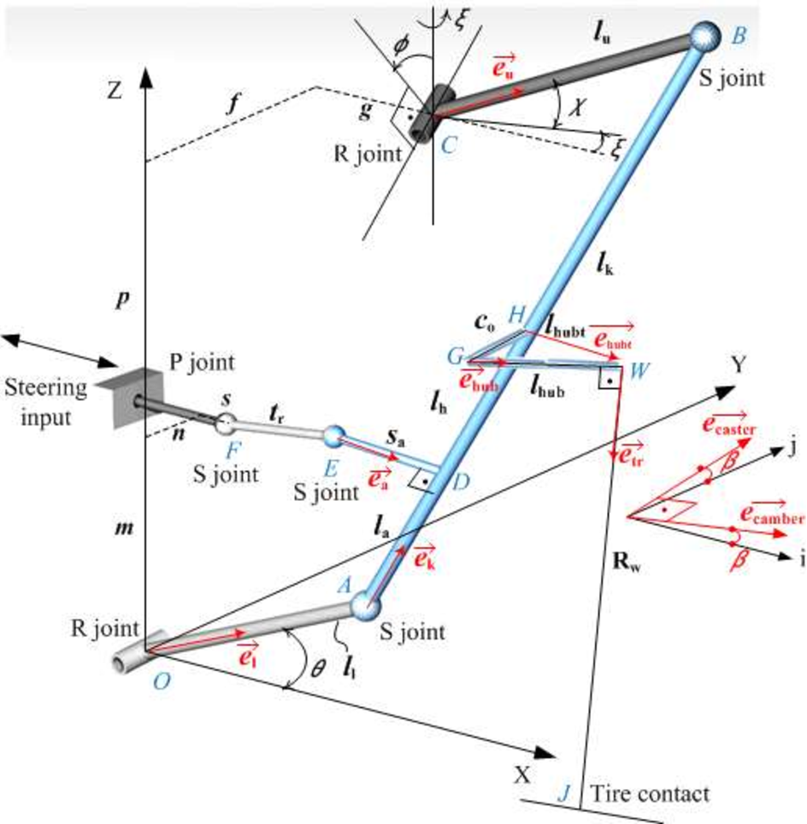
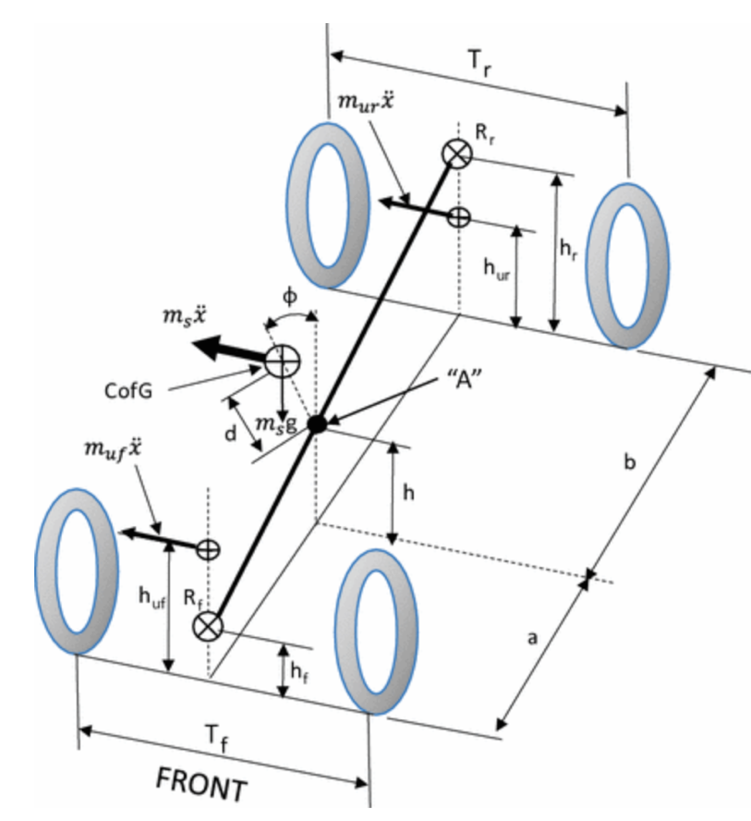
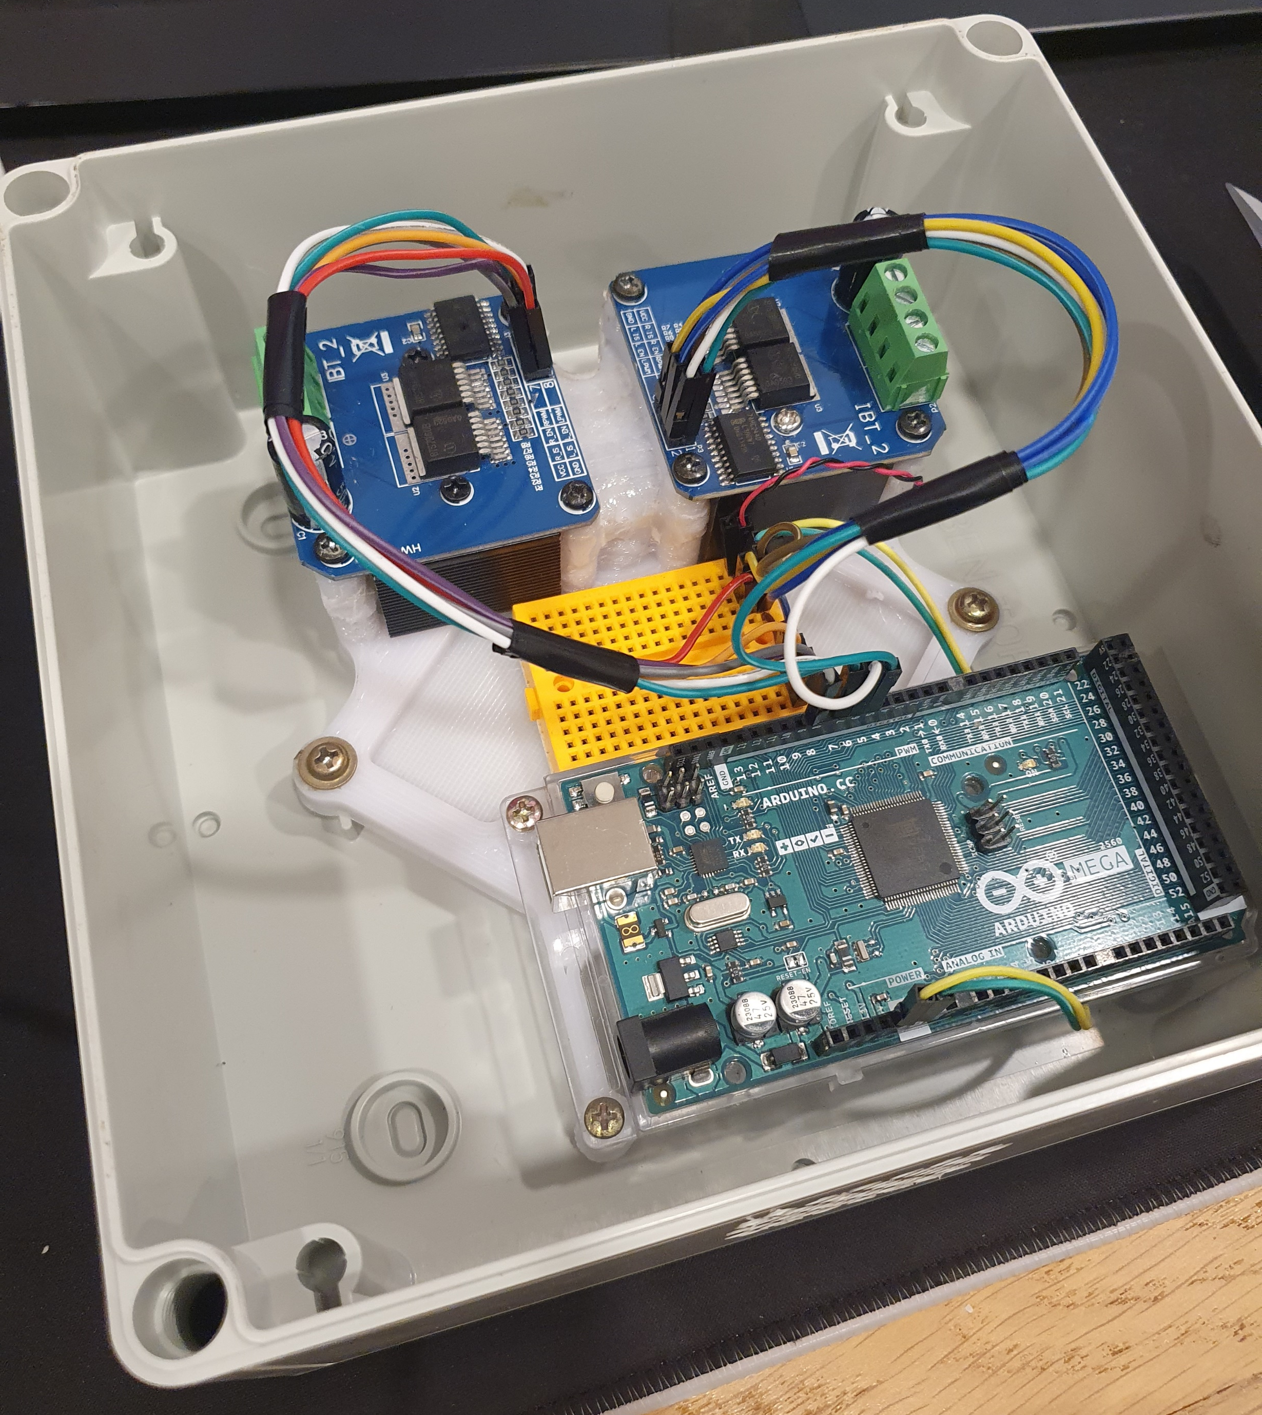
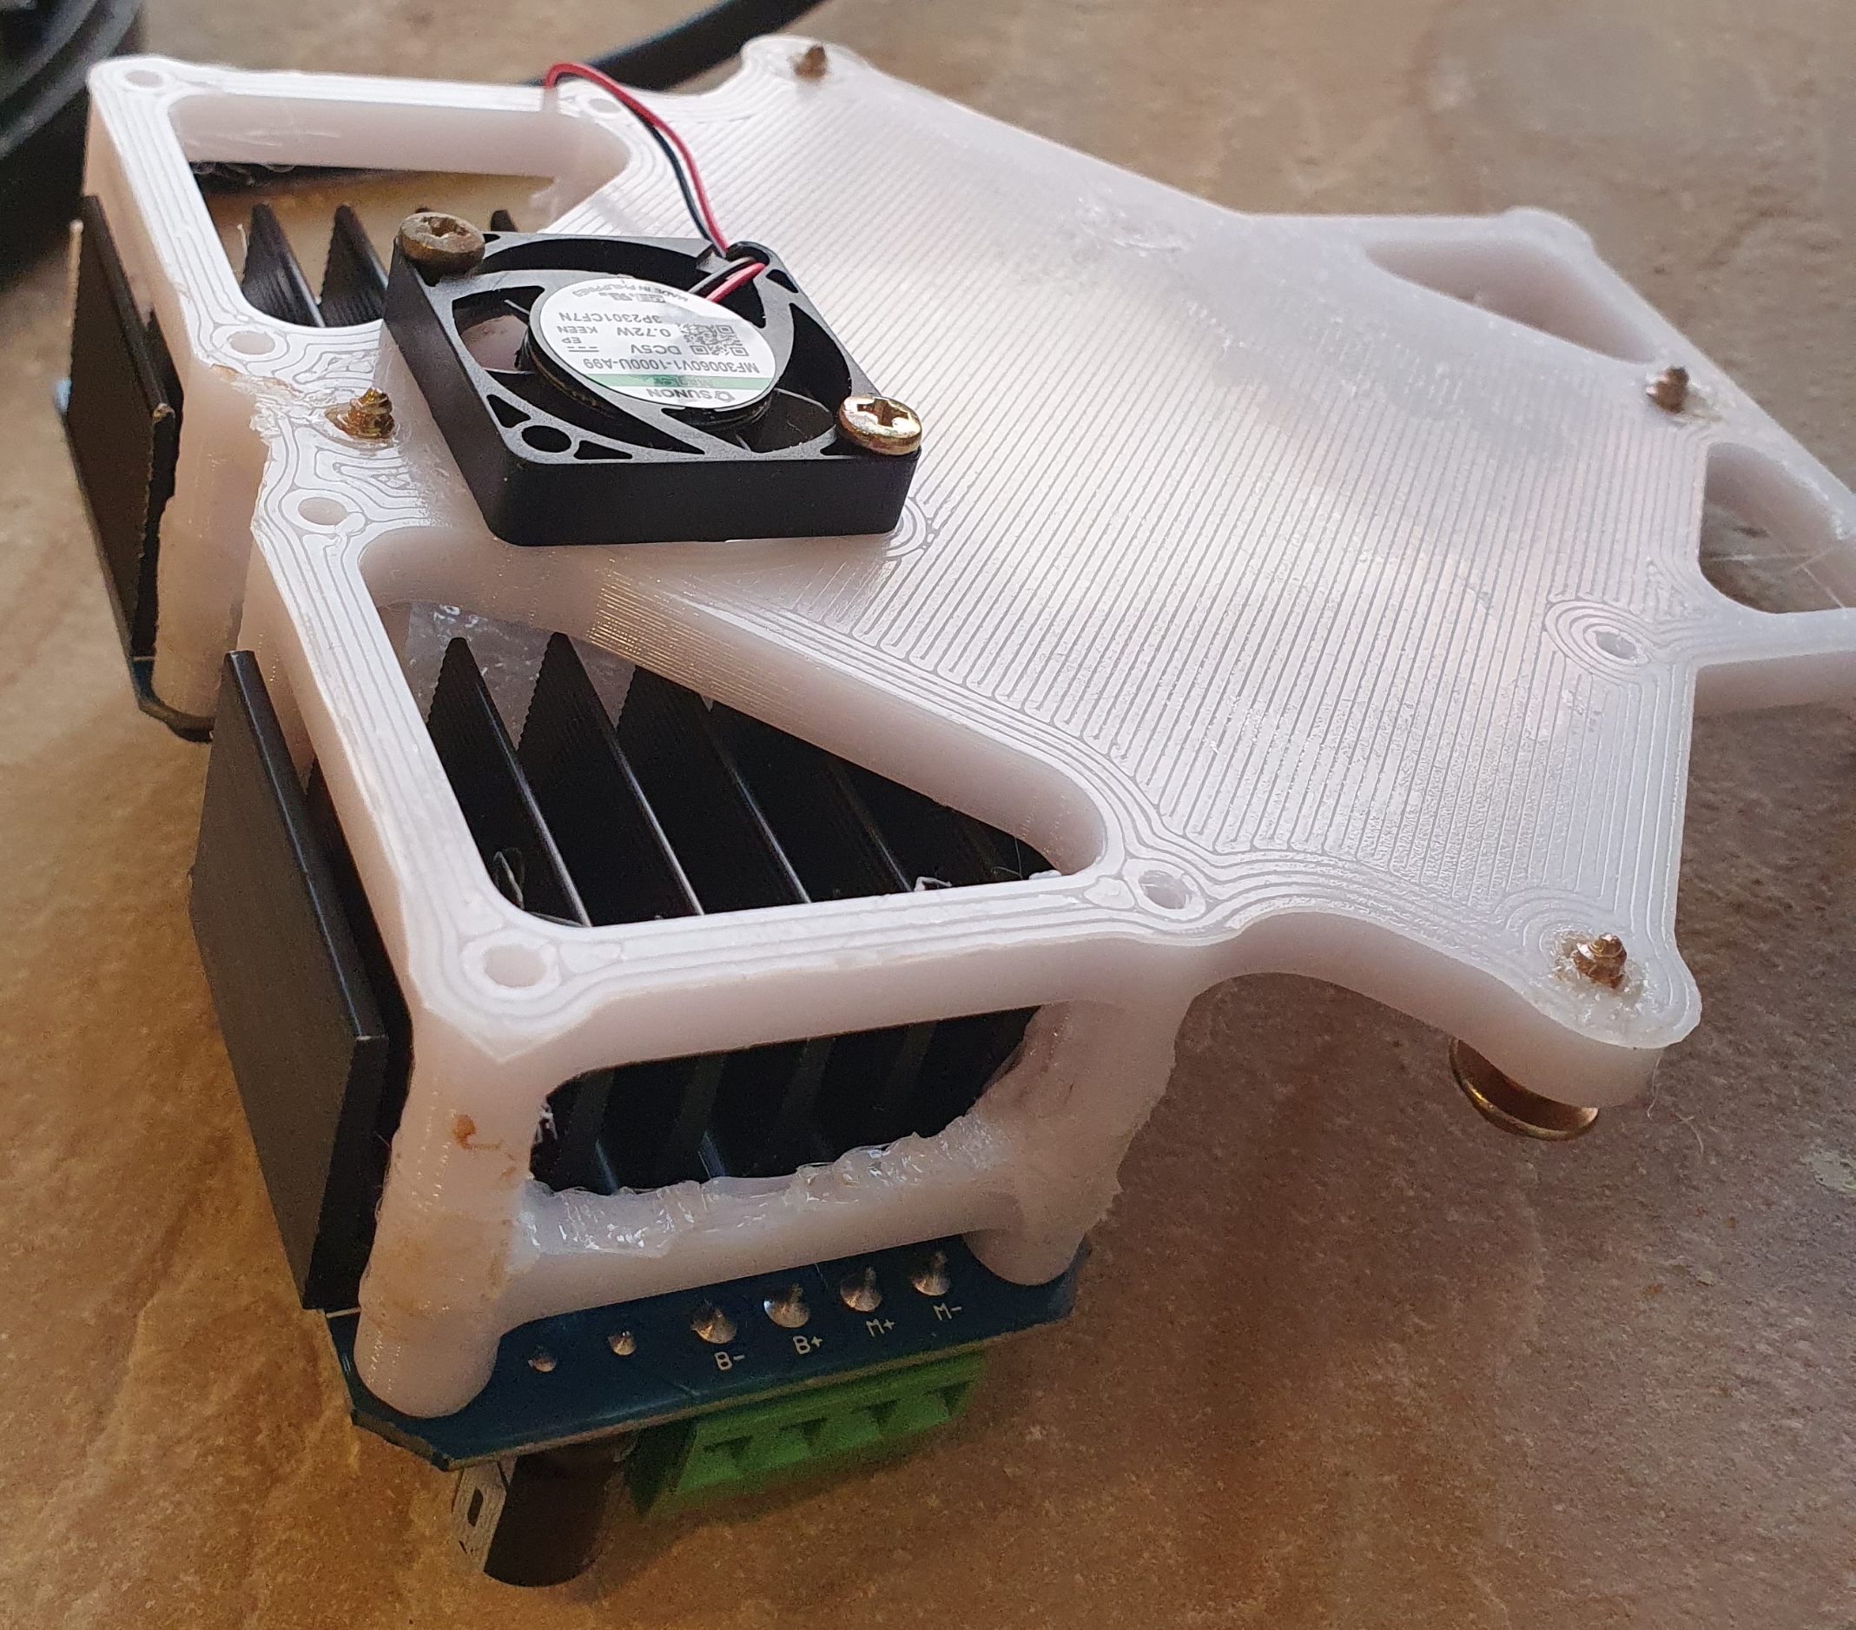
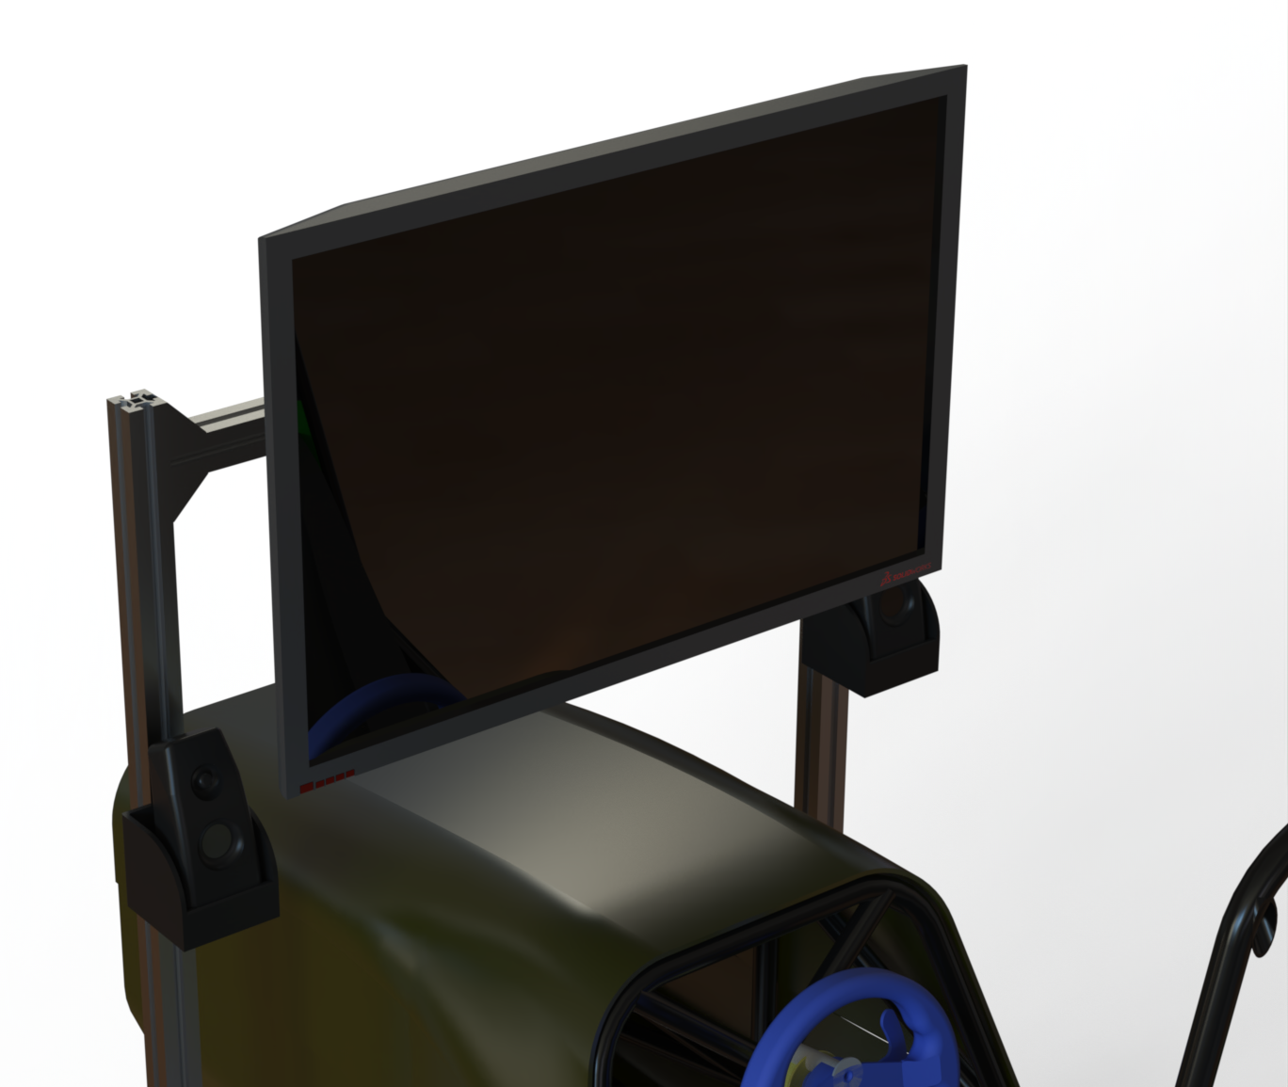
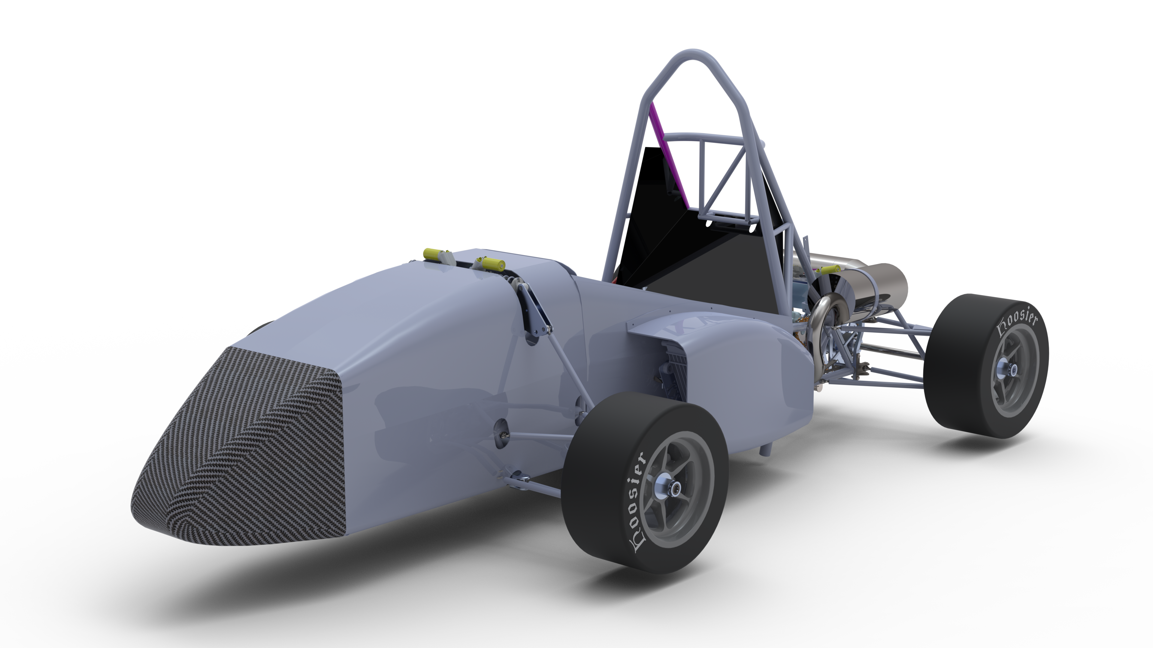
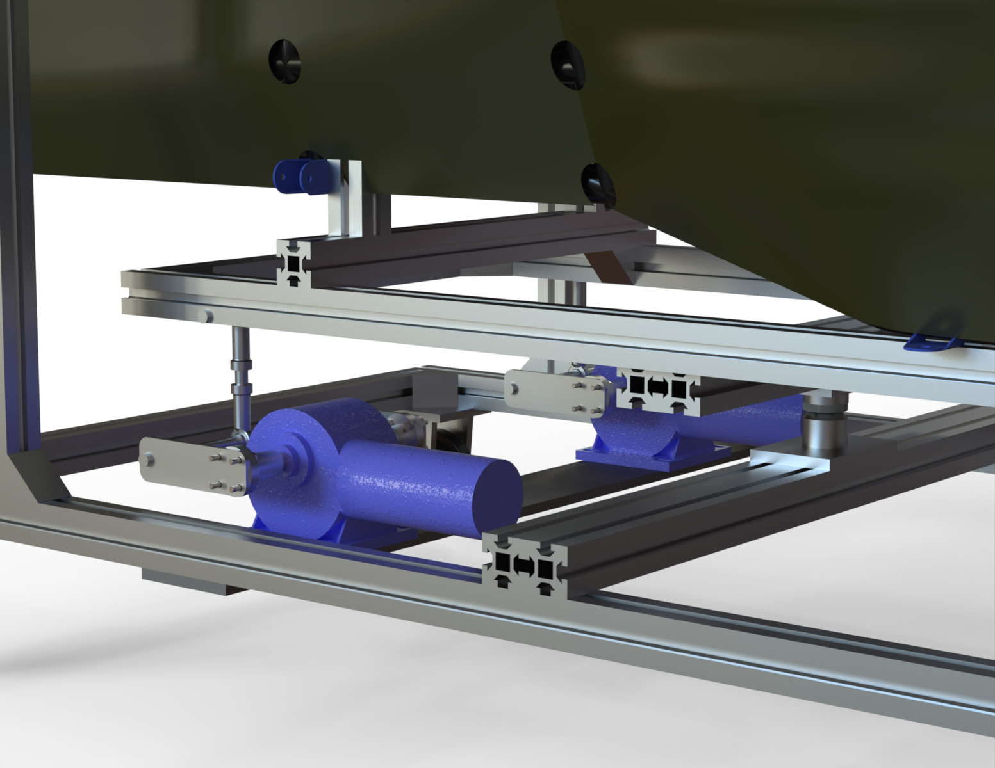
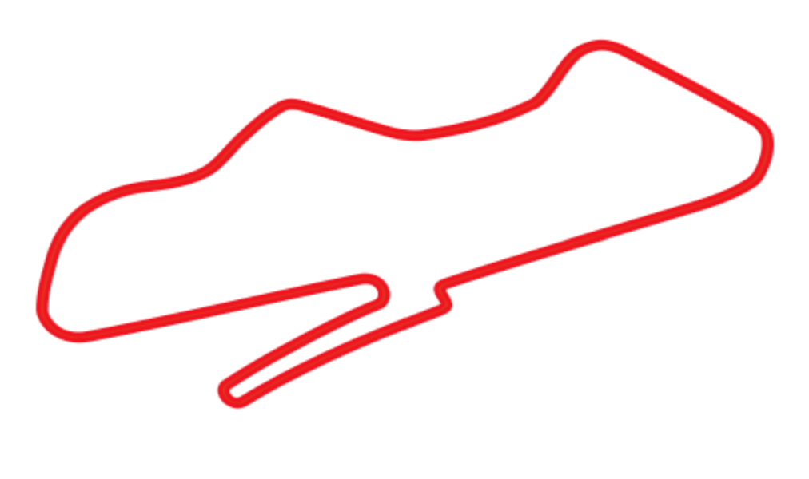
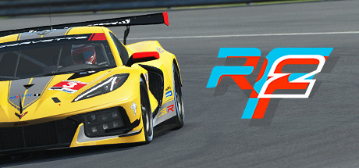
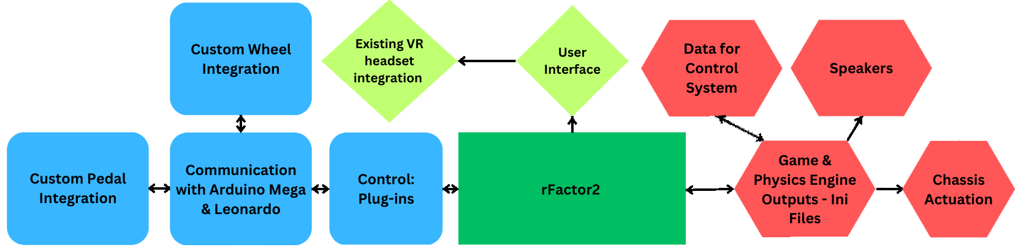
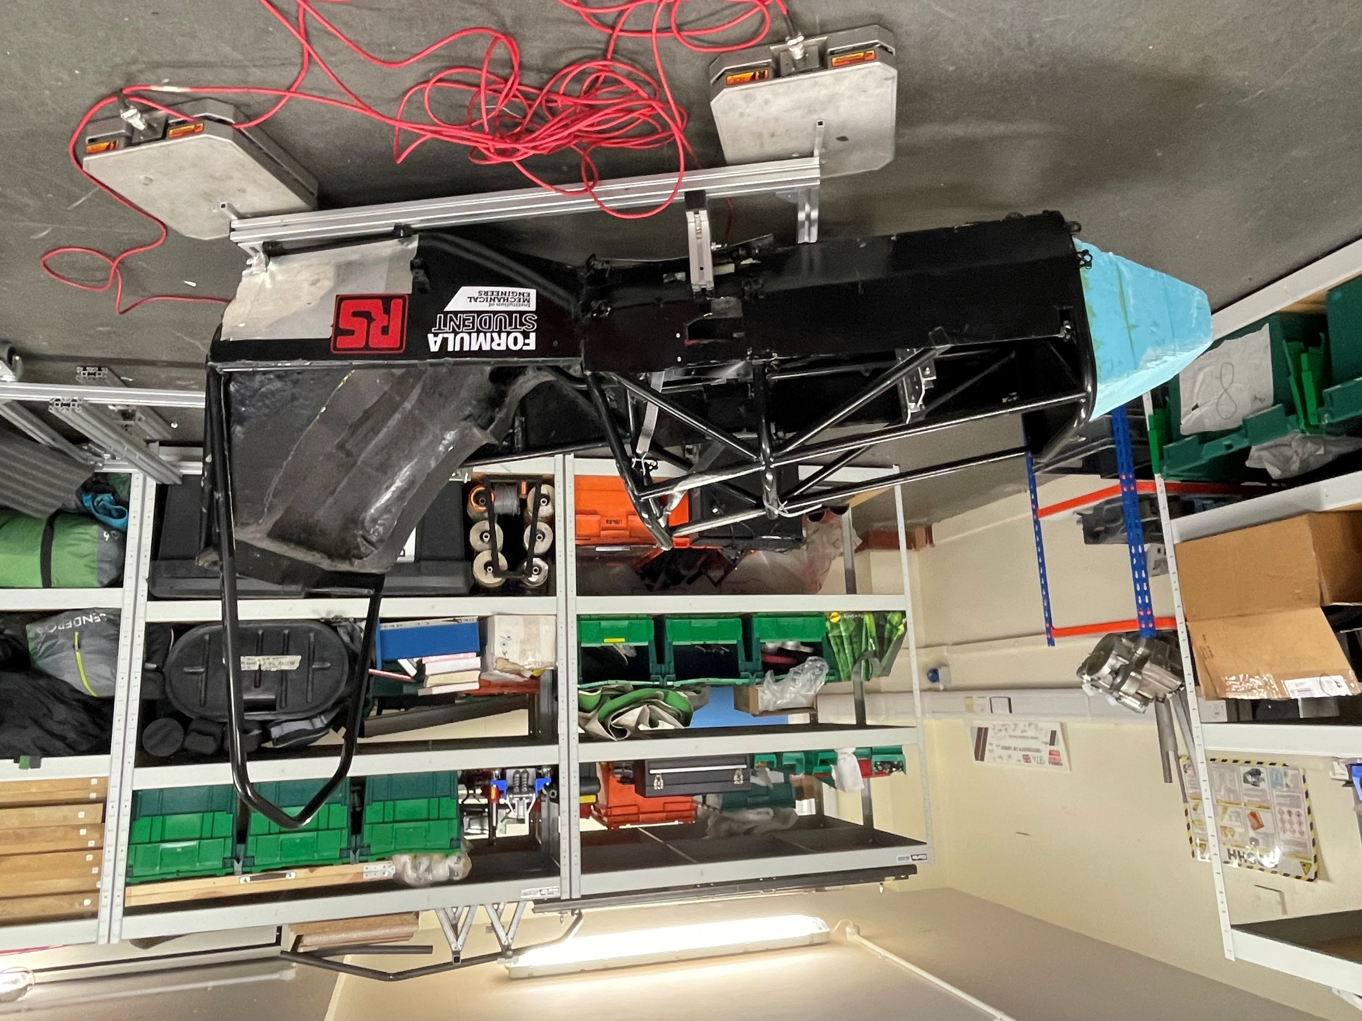
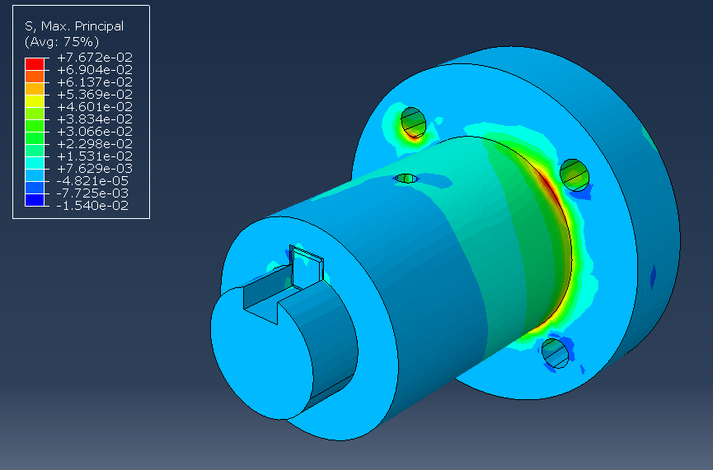
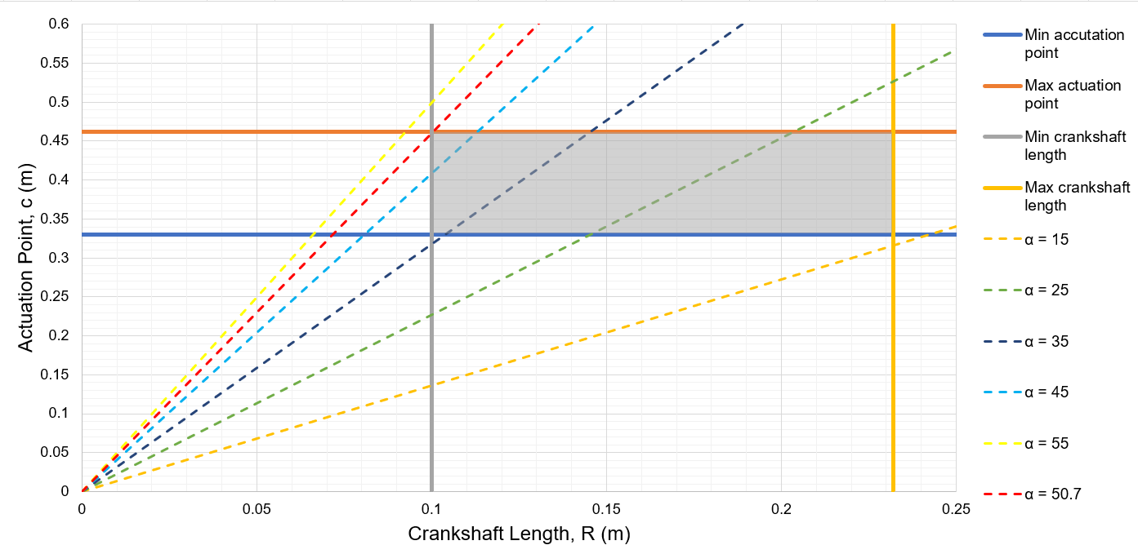
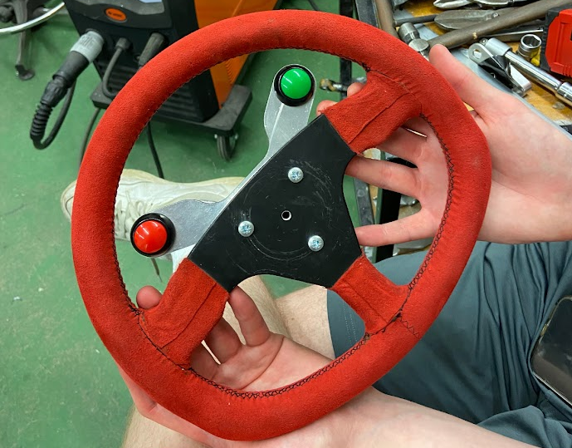


Virtual Racing
Building A Formula Student Car Simulator
Motion Control
Vehicle Kinematics
Two Actuators for Pitch and Roll
Custom Control System using Arduino & H-Bridge Motor Drivers
Custom Motion Cueing Algorithm developed in C++, running on the simulation computer
Safety Circuit with E-Stop
Use Ansys to simulate the vehicle powertrain.
High-fidelity tyre and track modeling
Advanced driver input model with realistic force feedback
Use CFD simulations to model the aerodynamics around the vehicle.
Analyze the suspension systems effects on vehicle handling.
Validate the kinematic model with Logitech model.
Figure 1: Surface pressure diagram (Chen et al., 2020)
Figure 2 and 3: Double wishbone suspension (Tanik and Parlaktas, 2016); Steady state cornering analysis (Barton and David, 2018)
Racetrack Overview
Motion Platform
Simulation Environment
Find CoM by weighing the motion platform at all 4 corners
FEA to ensure the components are of suitable strength.
Design Optimization to find the optimal crank length and actuation point within the constraits for the maximum angular acceleration
Custom plug-in, developed in C++, that communicates telemetry data between the simulation software, rFactor 2, and the simulator hardware to facilitate functions such as actuation
• In-simulator Leeds Gryphon Racing Car model created in 3ds Max
• Original racetrack design that showcases the full capabilities of the simulator's functions
Steering + Pedals
Wheel Force Feedback implemented via geared DC motor by varying Pulse Width Modulation values as a function of vehicle velocity, acceleration, road friction, and turn radius.
High-precision encoder for wheel positioning
Pedals use a simple lever-based system with potentiometers to measure acceleration and braking.
Signals and communication handled by Arduino Leonardo loaded with custom software.
MECH5080M Group 135
Alex Bury | Curtis Lovett | Jordan Partridge | Mathew Fuller | Albert (Qianli) Liang
Supervisor: Andrew Jackson

